Slide 1

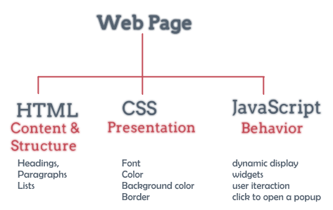
Hypertext Markup Language
(HTML) Part 2

Slide 2
Lesson content
Create a table in HTML
Frame
Iframes
Frameset
Marquee
Multimedia

Slide 3
1. Create a table in HTML
td or th
# | Code | Name | Price | Madein
1 | SP1 | Coca | 15 | VN
2 | SP2 | Pepsi | 20 | VN
3 | Sp3 | Sting | 17 | US
tr
table

Slide 4
1. Create a table in HTML
To create a table we use the tag:
<table> …….. </table>
Attributes:
caption: table header definition
border=“value”: border size.
width=“value”, height=“value”: table width and height. Can be ordered in 2 ways :
n: (n is a number) Set the width and height to n pixels
n%: Specify the width, height is n% width, height of the object containing the table.

Slide 5
1. Create a table in HTML
Attributes:
cellspacing=“value”: Spacing between 2 consecutive cells
cellpadding=“value”: Distance from cell corner to cell content
bgcolor=“color”: table background color
background=“image url”: The address of the image file as the background for the table. Relative paths should be used if possible.

Slide 6
1. Create a table in HTML
To create rows for the table use tag <tr>…</tr>
Note: how many rows the table has, there are as many pairs of these tags
Create cell:
Table header cell: <th>…</th>
Data cell: <td>…</td>
The total number of <td> and <th> tags equals the number of table cells. The row has as many cells as there are <td> and/or <th> tags within the corresponding <tr>…</tr> tag pair.
Note: To get a blank cell in the table (the cell has no data), it is necessary to set the cell content as: &nbsp;

Slide 7
1. Create a table in HTML
<td>, <th>
width, height
align=left, right, center, justify.
valign=top, middle, bottom.
colspan=“n”: Merge columns, default =1
rowspan=“n”: Merge rows, default =1
nowrap: it will make the data in the cell not auto-renew

Slide 8
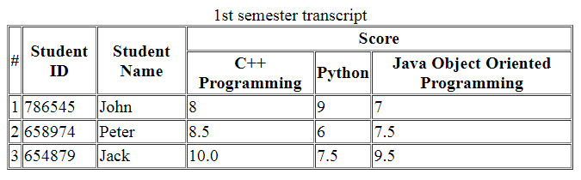
1. Create a table in HTML
<table border="1" cellpadding="1" cellspacing="1">
<caption>1st semester transcript</caption>
<tr>
<th rowspan="2">#</th>
<th rowspan="2">Student ID</th>
<th rowspan="2">Student Name</th>
<th colspan="3">Score</th>
</tr>
<tr>
<th>C++ Programming</th>
<th>Python</th>
<th>Java Object Oriented Programming</th>
</tr>
<tr>
<td>1</td>
<td>786545</td>
<td>John</td>
<td>8</td>
<td>9</td>
<td>7</td>
</tr>
</table>
For example:

Slide 9
2. Frame
Allows dividing a web page into several parts, each containing the content of another website
Browsers may not support frames

Slide 10
3. Iframe
Create a frame containing the content of another website
This tag is in the body
Position can be changed with CSS
Attributes
src=“url”: Website address
height, width: frame size

Slide 11
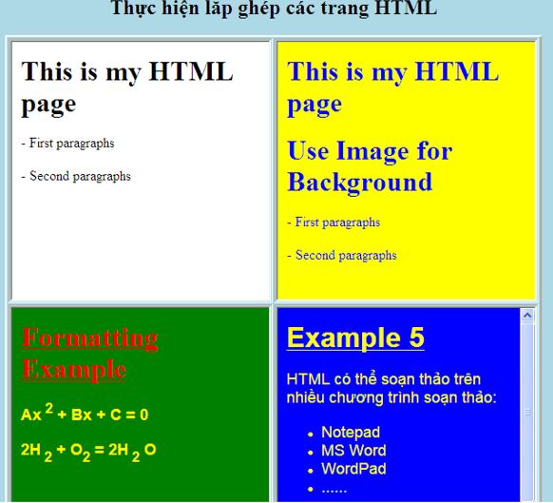
3. Iframe
Example
<table>
<tr align="center">
<td>
<iframe src="page1.html" width="400" height="300"></iframe>
</td>
<td>
<iframe src="page2.html" width="400" height="300"></iframe>
</td>
</tr>
<tr align="center">
<td>
<iframe src="page3.html" width="400" height="300"></iframe>
</td>
<td>
<iframe src="page4.html" width="400" height="300"></iframe>
</td>
</tr>
</table>

Slide 12
4. Frameset
Create a web page containing frames:
Replace <body>…</body> by:
<frameset>
frames
</frameset>
<noframes>
content in case the browser does not support the frame
</noframes>

Slide 13
4. Frameset
Some Attributes of <frameset>
rows = “n₁, n₂, … n_{k}” or cols = “n₁, n₂, … n_{k}”: Specifies that there are k rows (or columns), the i-th row (column) width is n_{i}. n_{i} is number, can be replaced with *: the remainder
frameborder = yes /no
framespacing = “n”: Distance between 2 frames

Slide 14
4. Frameset
For example:
Create a leftframe page that displays a list of links to websites
Create a frameset page linked to the leftframe page to display as desired.

Slide 15
4. Frameset
Create page
FramesetDetail.html
<body>
<font color="red">Page 1-2-3</font>
<ul>
<li><p><a href="page1.html" target="main">Page 1</a></p></li>
<li><p><a href="page2.html" target="main">Page 2</a></p></li>
<li><p><a href="page3.html" target="main">Page 3</a></p></li>
</ul>
<font color="red">Page 4-5-6</font>
<ul>
<li><p><a href="page4.html" target="main">Page 4</a></p></li>
<li><p><a href="page5.html" target="main">Page 5</a></p></li>
<li><p><a href="page6.html" target="main">Page 6</a></p></li>
</ul>
</body>

Slide 16
4. Frameset
Create Page
MainFrame.html
<!DOCTYPE html>
<html>
<head>
<meta charset="utf-8" />
<title></title>
</head>
<frameset cols="30%,60%">
<frame name="framesetdetail"
target="main" src="FramesetDetail.html">
</frame>
<frame name="main" src="introduction.html"></frame>
</frameset>
</html>

Slide 17
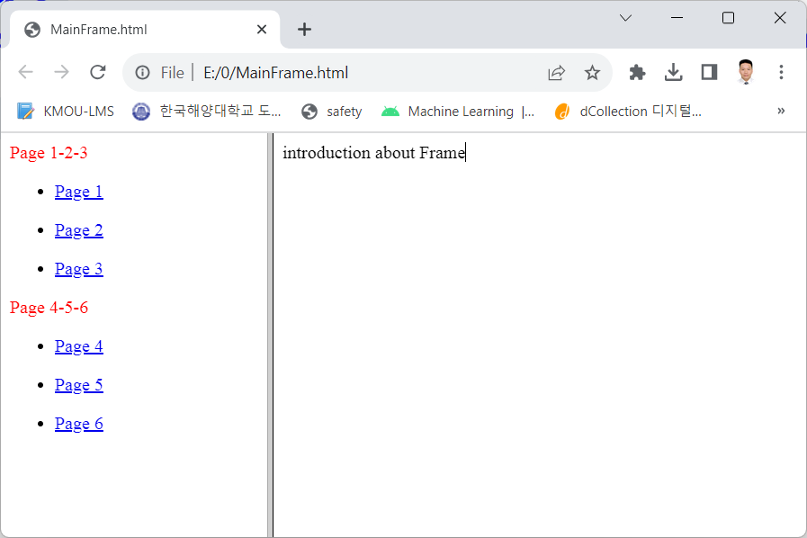
4. Frameset

Slide 18
5. Marquee
The <marquee> tag will run most of the objects in the tag such as: text, images, other formats.
The syntax is as follows : <marquee> running object </marquee>

Slide 19
5. Marquee
The attribute direction (direction of running):
By default, objects run from right to left. However, we can change the running direction.
Attribute values: down, left, right, up
Behavior property (run type):
Slide: run 1 time then stop
Scroll : run normally
Alternate: run over and run back

Slide 20
5. Marquee
Scrollamount attribute (running speed):
Helps to increase or decrease the running speed, this property takes the run value as an integer
Loop attribute (loop mode):
Repeat 1 time : loop = 1
Repeat non-stop: loop = -1

Slide 21
5. Marquee
<body>
<marquee direction="right" behavior="scroll" loop=-1 scrollamount=10>
Run from right to right, scroll mode, continuous loop, running speed 10
</marquee>
<marquee direction="left" behavior="slide" loop=1 scrollamount=10>
Run from left to left, slide style, repeat 1 time, running speed 10
</marquee>
<marquee direction="down" behavior="scroll" loop=-1 scrollamount=10>
<p align="center"> Run from the top, scroll mode, continuous loop,
running speed 10 </p>
</marquee>
<marquee direction="up" behavior="scroll" loop=1 scrollamount=10>
<p align="center"> Run from the bottom up, scroll mode, repeat 1 time,
running speed 10 </p></marquee>
</body>

Slide 22
6. Multimedia
<audio> (HTML5)
Insert music into a web page
<audio controls> <source src= "file_music.mp3" type="audio/mpeg"> Your browser does not support this audio format. </audio>

Slide 23
6. Multimedia
<video>
Insert video clips into web pages
<video width="320" height="240" controls>
<source src="media/movie.mp4" type="video/mp4">
Your browser does not support the video tag.
</video>

Slide 24
6. Multimedia
Insert flash, video in general
tag object
tag embed
How to insert 1 Video from Youtube into HTML?

Slide 25


Hey! Coding is easy!
END

